Slide 1
Dr. Jayaraj P B Associate Professor Department of Computer Science & Engineering, NIT Calicut
Linear Regression
1

Slide 2
Outline
Liner Regression – Overview
Parameters of the Regression
How to model the parameters
Cost Function
Gradient Descent Algorithm
Model Evaluation
2

Slide 3
Linear Regression
Linear Regression is a method in statistics used to predict the value of a variable based on another variable.
Linear regression focuses on the linear dependence of variables.
Graphically, given a set of points the aim of linear regression is to find the line that best fits the points.

Slide 4
Linear regression
Linear regression is a way to identify a relationship between two or more variables and use these relationships to predict values of one variable for given value(s) of other variable(s).
Regression captures the correlation between variables observed in a data set
Linear regression assume the relationship between variables can be modelled through linear equation or an equation of line

Slide 5
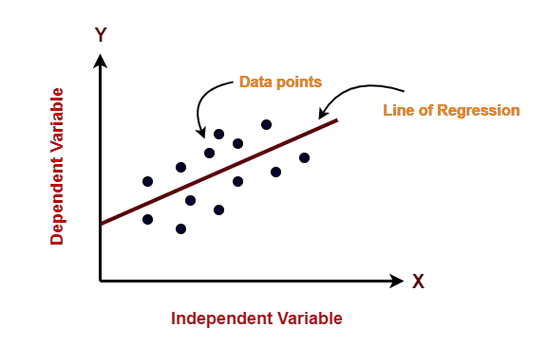
Linear Regression
Linear regression model represents the linear relationship between a dependent variable and independent variable(s) via a sloped straight line.

Slide 6
Problem Definition
Consider the problem of house price prediction.
Let the price of a house (R), depend on only one factor the number of rooms (A)
The input dataset contains (number of rooms, price of house)
The task is to predict the price of a house for a given input of number of rooms.
Number of Rooms (A) | Price of House
1 | 20
2 | 30
3 | 40

Slide 7
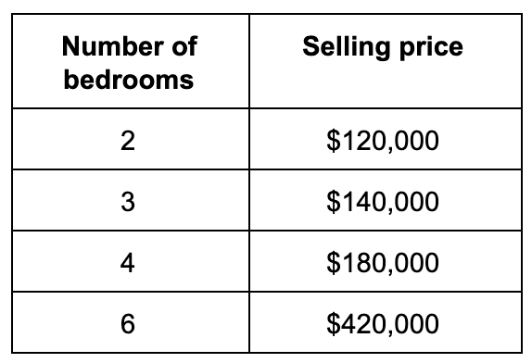
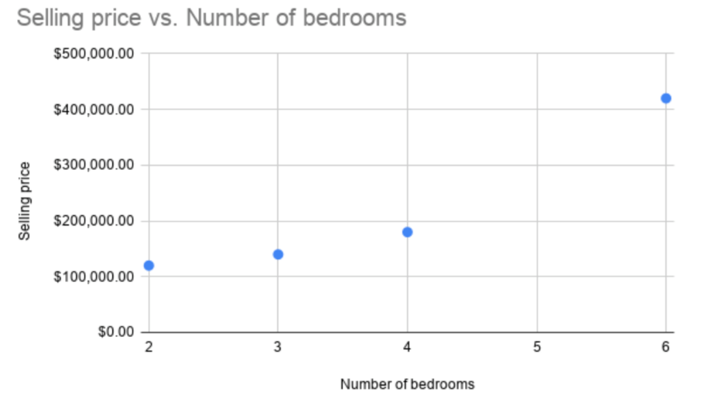

Slide 8
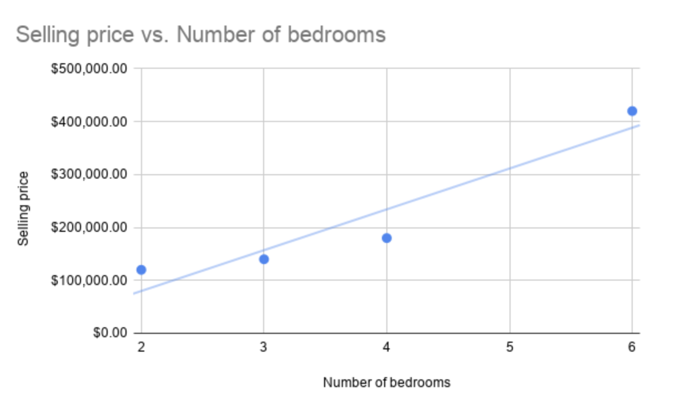
This model assumes a linear relationship between the dependent variable and the predictor variable

Slide 9
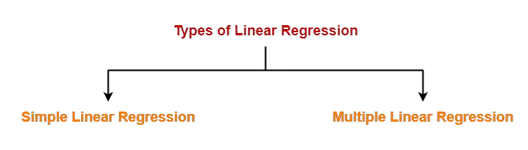
Types of Linear Regression

Slide 10
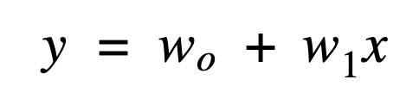
Simple Linear Regression
In this equation:
y is the output variable. It is also called the dependent variable in statistical modelling. It represents the continuous value that we are trying to predict.
x is the input variable. In machine learning, x is referred to as the feature, while in statistics, it is called the independent variable.
w0 is the bias term or y-axis intercept.
w1 is the regression coefficient or scale factor. In classical statistics, it is the equivalent of the slope on the best-fit straight line that is produced after the linear regression model has been fitted.
wi are called weights in general.
The goal of the regression analysis (modelling) is to find the values for the unknown parameters of the equation; that is, to find the values for the weights w0 & w1.

Slide 11

Multiple Linear Regression
Both simple and multiple linear regressions assume that there is a linear relationship between the input variable(s) and the output target variable.
The main difference is the number of independent variables that they take as inputs. Simple linear regression just takes a single feature, while multiple linear regression takes multiple x values.
Where xi is the i-th feature with its own wi weight

Slide 12
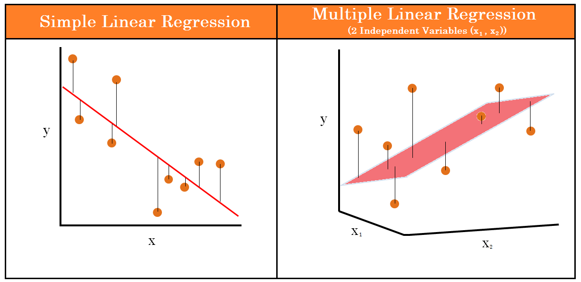
The simple linear regression model can be represented graphically as a best-fit line between the data points, while the multiple linear regression model can be represented as a plane (in 2-dimensions) or a hyperplane (in higher dimensions).

Slide 13
Multiple Linear Regression
Price = f (Area location, floor, Ageing, Amenities)

Slide 14
Training the Linear Regression
Optimization Algo
input
Model
Prediction
Dataset
expected output
Loss Function
Loss

Slide 15
Training the Linear Regression
We train the linear regression algorithm with a method named Mean Squared Error (MSE). The goal of training is to find the weights w_{i} in the linear equation y = w₀ + w₁x.
This has four main steps in machine learning:
1. Random weight initialization. In practice, w₀ and w₁ are unknown at the beginning. The goal of the procedure is to find the appropriate values for these model parameters. To start the process, we set the values of the weights at random.
2. Input the initialized weights into the linear equation and generate a prediction for each observation point. To continue with the example that we’ve already used:

Slide 16
Training the Linear Regression
3. Calculate the MSE
We obtain residuals by calculating actual values - predicted values for each observation. We square the residuals. And we sum the residues
4. Model parameter selection to minimize the error.
We find the best parameters for the linear model by defining a cost function and minimizing it via gradient descent.

Slide 17
Training the Linear Regression
Gradient Descent
input
R = αA + β
Prediction
(No of rooms, price)
expected output
Loss
MSE = ¹ (y − y
₎2
2
pred expected

Slide 18
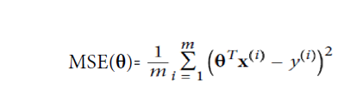
Cost Function
The cost function is a formal representation of an objective that the algorithm is trying to achieve.
In the case of linear regression, the cost function is the MSE (Mean Squared Error).
The algorithm solves the minimization problem - it tries to minimize the cost function in order to achieve the best fitting line with the lowest errors.
This is achieved through gradient descent.

Slide 19
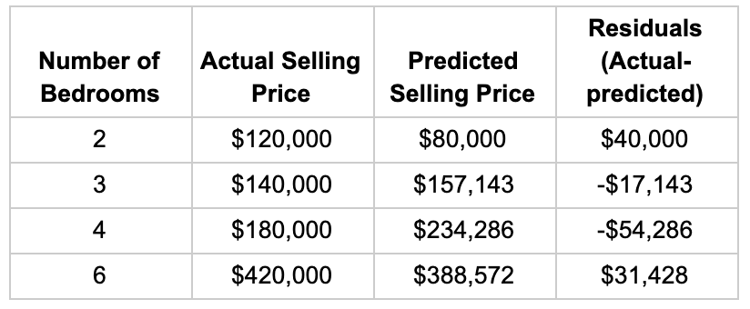


Slide 20
Gradient Descent
Gradient Descent is a very generic optimization algorithm capable of finding optimal solutions to a wide range of problems.
The general idea of Gradient Descent is to tweak parameters iteratively in order to minimize a cost function.

Slide 21
Gradient Descent
Gradient descent is a method of changing weights based on the loss function for each data point. We calculate the sum of squared errors at each input-output data point.
We take a partial derivative of the weight and bias to get the slope of the cost function at each point.
Based on the slope, gradient descent updates the values for the set of weights and the bias and re-iterates the training loop over new values
This iterative approach is repeated until a minimum error is reached, and gradient descent cannot minimize the cost function any further.

Slide 22
Gradient Descent

Slide 23

Gradient Descent Steps

Slide 24
Learning rate too small

Slide 25
Learning rate too large

Slide 27
Challenges
Finally, not all cost functions look like nice regular bowls. There may be holes, ridges, plateaus, and all sorts of irregular terrains, making convergence to the minimum very difficult.
if the random initialization starts the algorithm on the left, then it will converge to a local minimum, which is not as good as the global minimum.
If it starts on the right, then it will take a very long time to cross the plateau, and if you stop too early you will never reach the. global minimum

Slide 28
elongated bowl

Slide 29
In fact, the cost function has the shape of a bowl, but it can be an elongated bowl if the features have very different scales.
Figure above shows Gradient Descent on a training set where features 1 and 2 have the same scale (on the left), and on a training set where feature 1 has much smaller values than feature 2 (on the right)

Slide 30
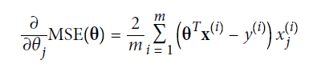
Batch Gradient Descent
To implement Gradient Descent, you need to compute the gradient of the cost function with regards to each model parameter θ.
In other words, you need to calculate how much the cost function will change if you change θ just a little bit. This is called a partial derivative.

Slide 31
In Batch Gradient Descent, all the training data is taken into consideration to take a single step.
We take the average of the gradients of all the training examples and then use that mean gradient to update our parameters.
So that’s just one step of gradient descent in one epoch.

Slide 32
Stochastic Gradient Descent
The main problem with Batch Gradient Descent is the fact that it uses the whole training set to compute the gradients at every step, which makes it very slow when the training set is large.
At the opposite extreme, Stochastic Gradient Descent just picks a random instance in the training set at every step and computes the gradients based only on that single instance.
Obviously this makes the algorithm much faster since it has very little data to manipulate at every iteration.
It also makes it possible to train on huge training sets, since only one instance needs to be in memory at each iteration

Slide 33
Stochastic Gradient Descent
If the learning rate is reduced too slowly, you may jump around the minimum for a long time and end up with a suboptimal solution if you halt training too early.

Slide 34
Mini-batch Gradient Descent
The last Gradient Descent algorithm we will look at is called Mini-batch Gradient Descent. It is quite simple to understand once you know Batch and Stochastic Gradient Descent: at each step, instead of computing the gradients based on the full training set (as in Batch GD) or based on just one instance (as in Stochastic GD), Minibatch GD computes the gradients on small random sets of instances called minibatches.
The main advantage of Mini-batch GD over Stochastic GD is that you can get a performance boost from hardware optimization of matrix operations, especially when using GPUs.

Slide 35
hyperparameter learning rate
One consideration to bear in mind when using gradient descent: the hyperparameter learning rate.
The learning rate refers to how much the parameters are changed at each iteration.
If the learning rate is too high, the model fails to converge and jumps from good to bad cost optimizations.
If the learning rate is too low, the model will take too long to converge to the minimum error.

Slide 36
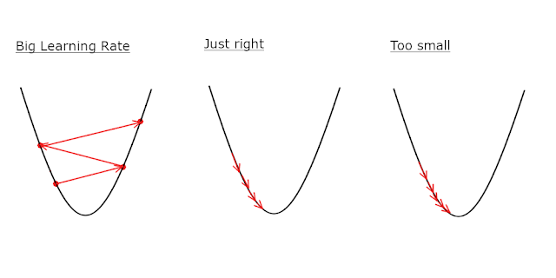

Slide 37
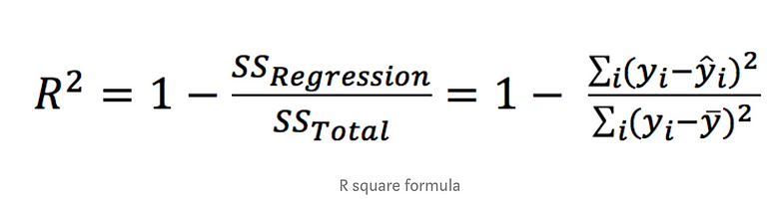
Model evaluation
How do we evaluate the accuracy of our model?
There are various metrics to evaluate the goodness of fit:
Mean Squared Error (MSE).
Mean Absolute Error(MAE)
R²
The sum of squared of prediction error divided by the total sum of square which replace the calculated prediction with mean.

Slide 38
Polynomial Regression
What if your data is actually more complex than a simple straight line? Surprisingly, you can actually use a linear model to fit nonlinear data.
A simple way to do this is to add powers of each feature as new features, then train a linear model on this extended set of features. This technique is called Polynomial Regression

Slide 39
Polynomial Regression
Polynomial Regression is a regression algorithm that models the relationship between a dependent(y) and independent variable(x) as nth degree polynomial. The Polynomial Regression equation is given below:
y= b₀+b₁x₁+ b₂x₁²+ b₂x₁³+...... b_{n}x₁^{n}

Slide 40
Polynomial Regression

Slide 41
Polynomial regression degree 3

Slide 42
Polynomial regression degree 14
The regression line will curve further if we increase the polynomial degree, the regression line will be overfitting into all the original values of X.

Slide 43
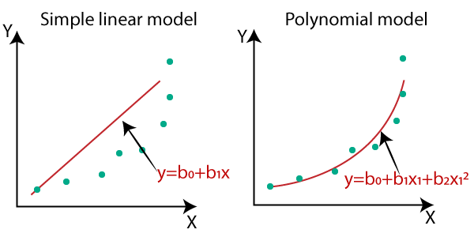
Polynomial Regression

Slide 44
Equation of the Polynomial Regression Model:
Simple Linear Regression equation: y = b₀+b₁x .........(a)
Multiple Linear Regression equation y= b₀+b₁x+ b₂x₂+ b₃x₃+....+ b_{n}x_{n} .........(b)
Polynomial Regression equation: y= b₀+b₁x + b₂x²+ b₃x³+....+ b_{n}x^{n} ..........(c)

Slide 45
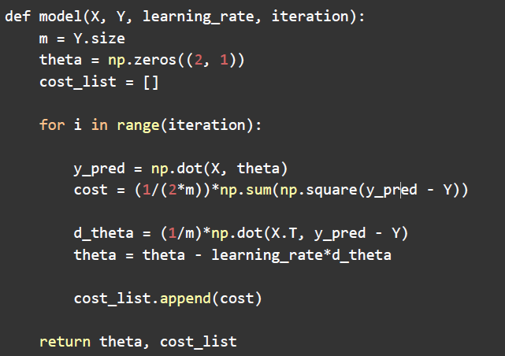
Python implementation

Slide 46
THANKS!!

